Slide 1
Research Proposal
Mojdeh Karbalaee Motalleb

Slide 2
Background
Secondary and High school: National Organization for Development of Exceptional Talents (2004-2011)- Mathematics and physics
Total GPA: 19.73/20
Bachler of Science: Amirkabir University of Technology (2011-2015)- Electrical Engineering(Communication Systems)
Total GPA:18.28/20
Master of Science: Amirkabir University of Technology (2015-2017)-Telecommunication
Total GPA:17.13/20
PHD : Tehran University (2017-2022)-Telecommunications and Networks
Total GPA: 18.86/20

Slide 3
Enjoyable Topics for me
Wireless System
Machine Learning (deep learning, reinforcement learning, …)
Python programming
Backend Developing
Signal Processing
Data Analysis

Slide 4
Reason of visiting information and communication research group
Working on Massive MIMO
Using Machine Learning (Deep Learning) Algorithms
Working on 6G
Implement Radar system in 6G

Slide 5
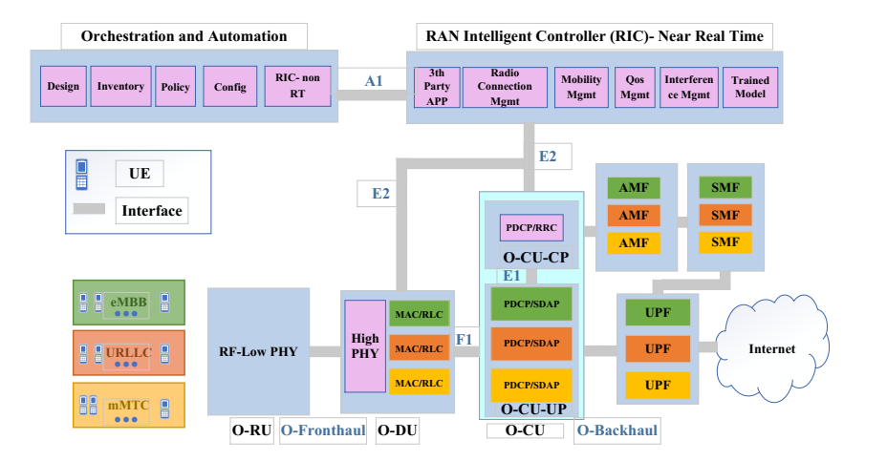
Resource Allocation in an Open RAN System using Network Slicing

Slide 6
Resource Allocation in an Open RAN System using Network Slicing
O-RU Association, Find Optimal #VNF, Power Allocation, PRB Allocation
Maximize Sum-Rate
Constraints
Maximum Delay -- URLLC Services
Minimum Data Rate – eMBB Services
Maximum Power – mMTC Services
Limited Fronthaul Capacity

Slide 7



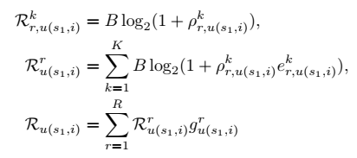
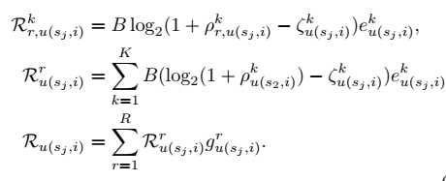
The Achievable Rate
SNR of UE “i” in Service “s”
Beamforming
eMBB Achievable Rate URLLC & mMTC Achievable Rate

Slide 8



Power of the O-RU, the Fronthaul Capacity & VNF Power
Power of O-RU
Fronthaul Capacity
VNF Power

Slide 9
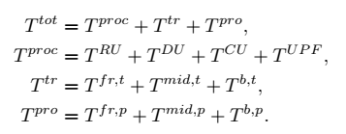

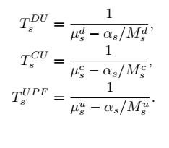

Mean Delay Time

Slide 10
Upcoming Works
Using Deep Reinforcement Learning for solving these kinds of problems
DDPG (Deep Deterministic Policy Gradient), DDQN, PPO (proximal policy optimization)
The problem → two-time scale
Large-time scale → Deep Q learning
Small-time scale → DDPG

Slide 11
Research Visit
Between 4-8 months (prefer 6 months)
Submit a new paper

